Slide 1
Binary Image Compression
Sas Cosmin Andrei
30431

Slide 2
Images and compression
Images are all around us, from application icons to animated GIFs to photos. Image files can take up a lot of space, so computers employ a range of algorithms to compress image files.
For the simplest of images, computers can use a compression algorithm called run-length encoding (RLE).

Slide 3
The Run-Length Encoding Algorithm
In run-length encoding, the computer replaces each row with numbers that say how many consecutive pixels are the same color, always starting with the number of white pixels.
I traded some memory to skip the last part of the definition.

Slide 4
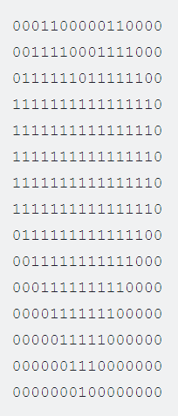
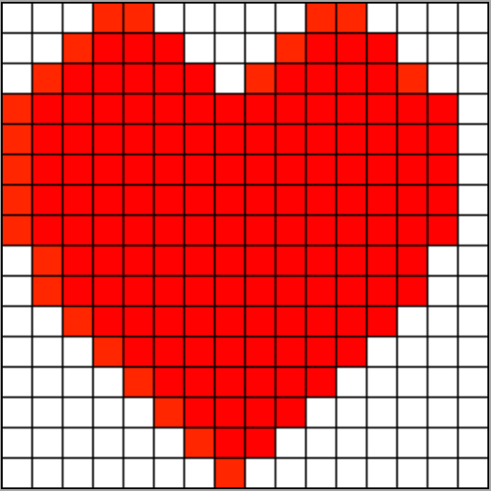
The Run-Length Encoding Algorithm

Slide 5
The Run-Length Encoding Algorithm
Pros:
Easy to implement
Lossless
Does not require high-end hardware
Cons:
Can return results bigger than the input

Slide 6






Results
Average cases:
128x128 pixels
2 KB
128x128 pixels
2 KB
1152x648 pixels
91 KB

Slide 7





Results
Worst cases:
Small images
16x16 pixels
32 B
32x32 pixels
128 B
Vertical lines
1152x648 pixels
91 KB

Slide 8


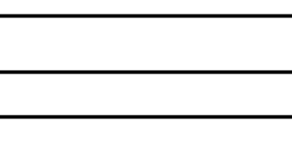
Results
Best cases:
Horizontal lines
1152x648 pixels
91 KB
1152x648
91 KB

Slide 9
Conclusion
This algorithm works for big images and will give great results for repetitive images.
The results of the algorithm can be improved by using it’s original form

Slide 10
Bibliography
https://www.khanacademy.org/computing/computers-and-the-internet/xcae6f4a7ff015e7d:digital-information/xcae6f4a7ff015e7d:data-compression/a/simple-image-compression
https://en.wikipedia.org/wiki/Run-length_encoding

